Slide 1
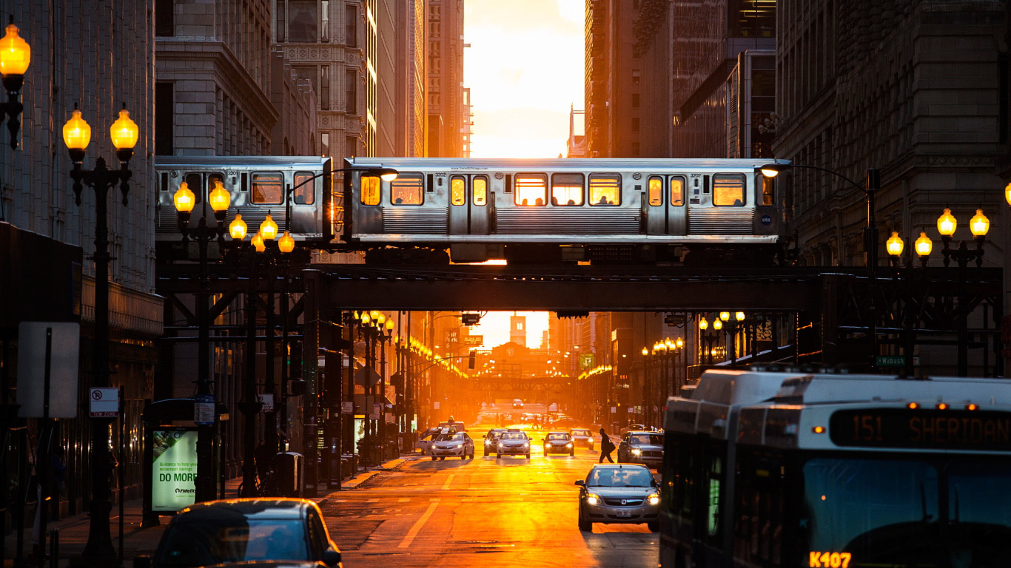

CTA CRIME PREDICTION
ITMD – 526 - Data Warehousing
Shubham Madke (A20445594)
Yash Agrawal (A20442647)
Tanmay Gaikwad (A20416375)
Deeptanshu Jariwala (A20448079)
Megha Shrivastava (A20450886)
This Photo by Unknown Author is licensed under CC BY-SA

Slide 2
Agenda
Data Preparation / Provisioning
ETL Implementation – Extract and Transform
Data Modelling - Normalization and Denormalization
Dashboard Implementation
Visualization and Charts
Interactive Elements
Analysis
Trends and Predictive Analytics and Other Insights
Documentation
References
ETL Process, Reporting Analytics

Slide 3
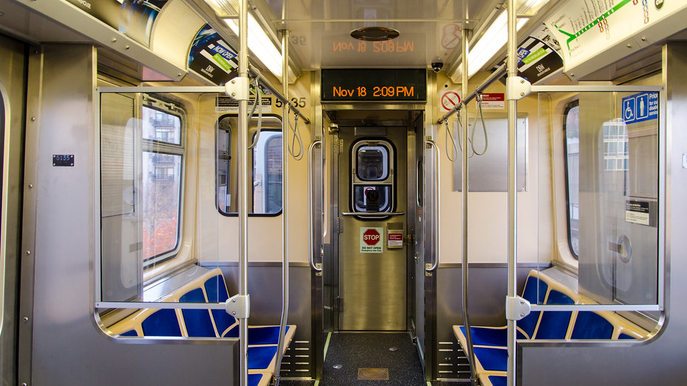
Research Problem
As the safety concern increases in Chicago area , most security agencies and the Police have been working around the clock to prevent crimes. However given the number of crimes and locations it is difficult to proactively prevent those crime from happening.
What are the main factor that encourage crime at a given location ?
How to predict whether crime is likely to happen at a given location and date?
What type of crime is more likely to happen at a location and date

Slide 4

DATA GATHERING
This Photo by Unknown Author is licensed under CC BY

Slide 5
DATA SOURCE AND DATA GATHERING LINKS
https://data.cityofchicago.org/Public-Safety/CTA-Crime/5xiy-qnsz
https://weatherstack.com/dashboard?logged_in=1

Slide 6
About the Data
CSV Files | Attributes | Type of Attribute
Incident Report | Time of Incident Date of Incident Site of Incident Incident description Incident Atm Restaurant Time_category | Continuous Discrete Nominal Binary Nominal
Weather Data | Humidity Temperature Cloudcover Heatindex Sunrise Sunset Moonrise moonset | Nominal Continuous Discrete
Size of Incidents Data: 603 rows
We have build the crime data
Fetched the corresponding weather data
Period : January , February and March 2020

Slide 7
Three groups of data will be collected and preprocessed to develop the variables
1.
ETL PROCESS1
SITE INFORMATION
2.
ETL PROCESS 2
WEATHER DATA
3.
SQL CROSS JOIN OPERATION

Slide 8
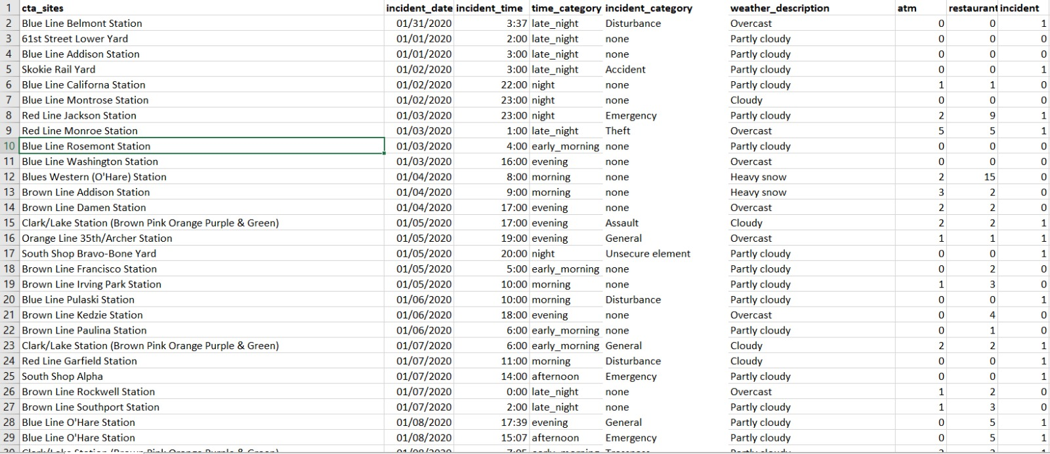
BASIC CTA CRIME DATA

Slide 9
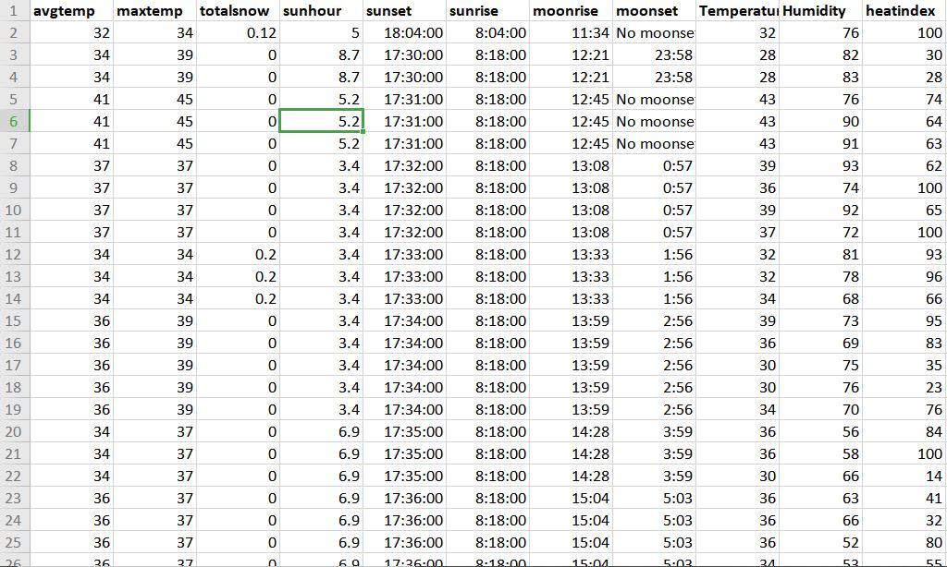
BASIC WEATHER DATA

Slide 10






ETL PROCESS

Slide 11
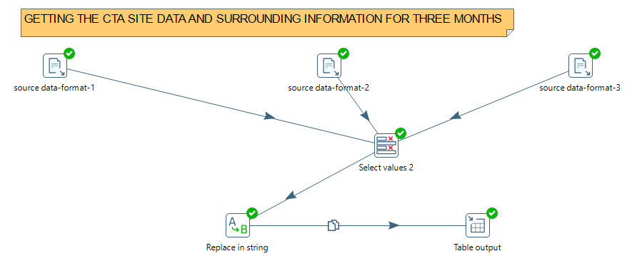
PENTAHO (ETL PROCESS)
From this transformation we are getting the cta sites and surrounding information of three months
Here we have selected the needed values for our data modelling
We have replaced the crime_category string with the severity

Slide 12
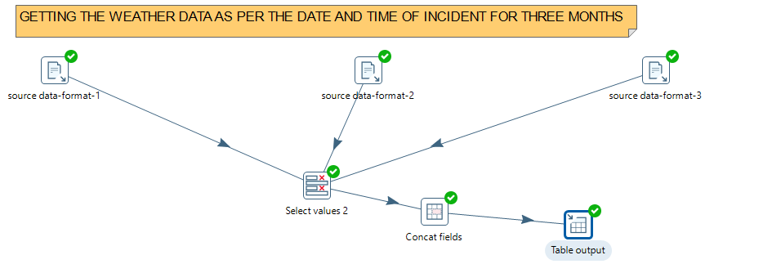
PENTAHO (ETL PROCESS 2)
From this transformation we are getting the weather data information of three months
Here we have selected the needed values for our data modelling
We have concatenated the sundata with its rsing and setting time.

Slide 13
ETL TRANSFORMATIONS
After doing etl and string and concat operation our whole data consists of two new changes
Changing the incident_category into the severity scale
Changing the sunrise and sunset data into concatination of sundata.
So our final two tables will have type of severity in cta table
And sundata new column in temperature table.

Slide 14
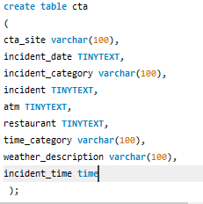
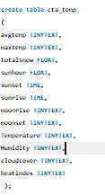
SQL QUERY FOR COMBINING TWO DATASET’S AND CREATING NEED TABLES FOR ETL PROCESS

Slide 15
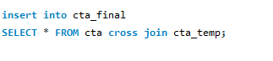
JOINING OPERATION
This operation will consolidate the cta crime and surrounding information data and the weather data into single dataset

Slide 16
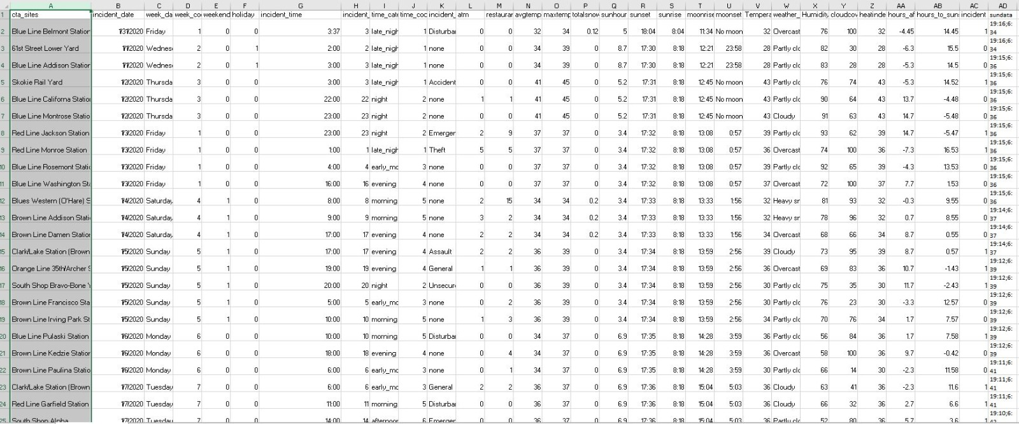
OUR CONSOLIDATED DATA LOOKS LIKE THIS

Slide 17

DATA VISUALIZATION

Slide 18
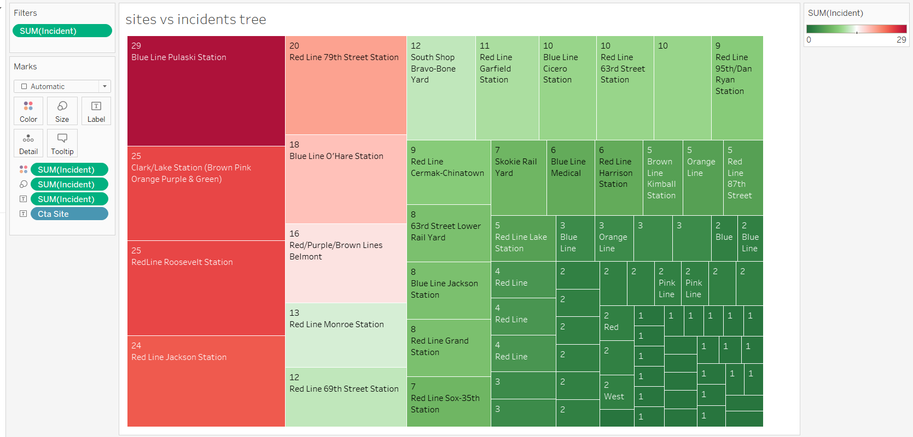
The above tree chart describes the total number of crime incidents at the CTA sites in a form that is easy to understand. Green refers to low number of crime incidents and it progresses towards red through white.

Slide 19
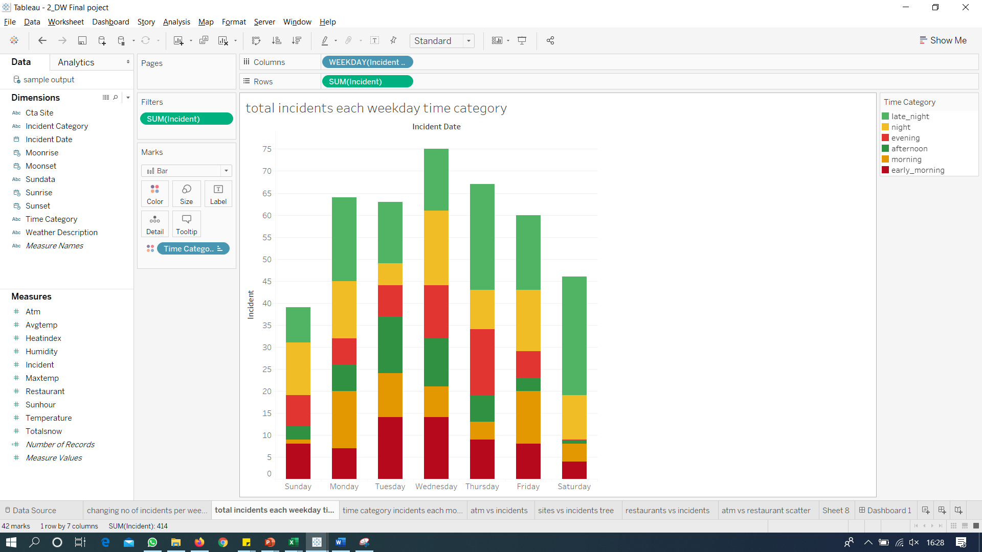
This graph illustrates that According to different time category in each day of the week the total crimes are reported

Slide 20
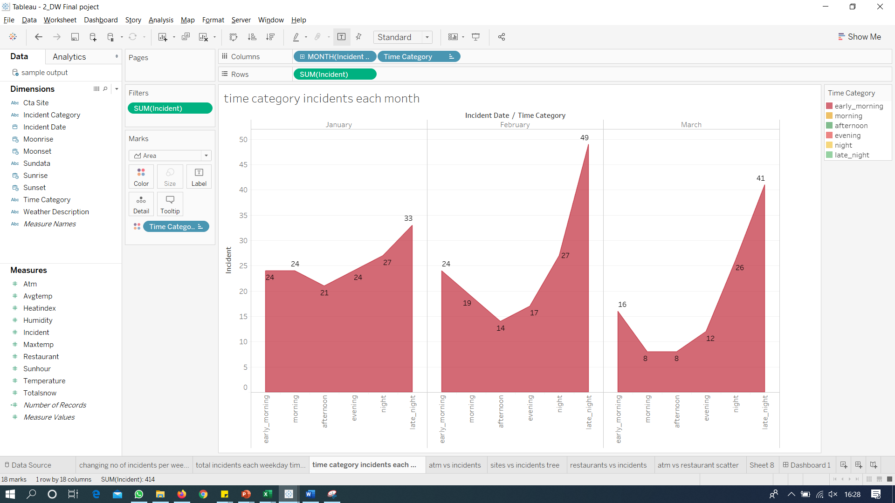
According to this graph, incident are counted according to different time category and 3 months. It shows that most of the incidents happen in late night.

Slide 21
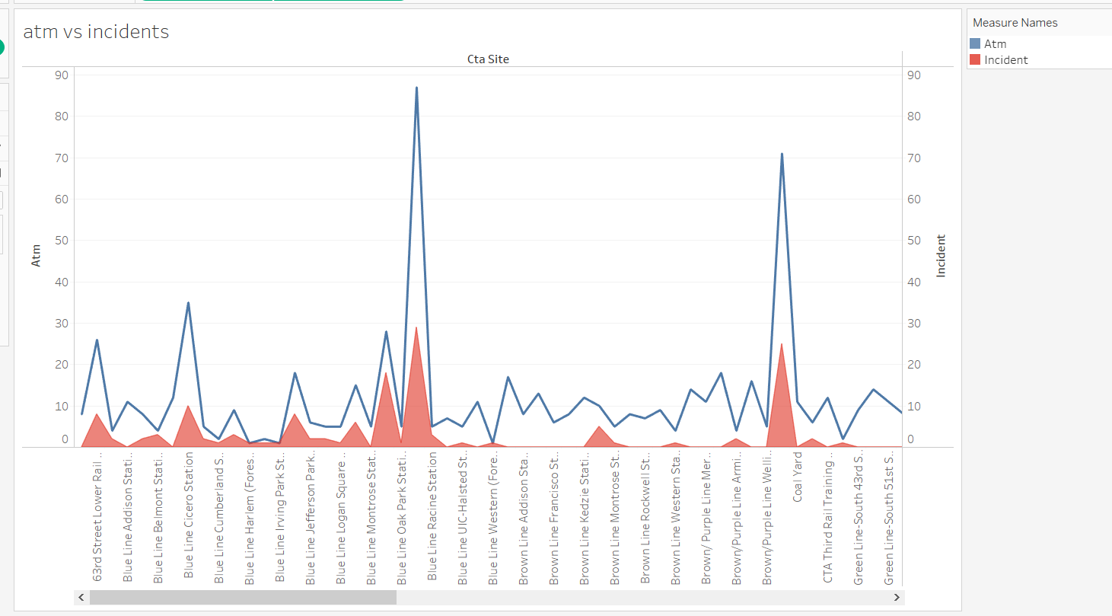
This is a dual axis chart that represents data for no. of ATMs and crime incidents at CTA sites. The chart helps
us to understand a direct co-relation between the two.

Slide 22
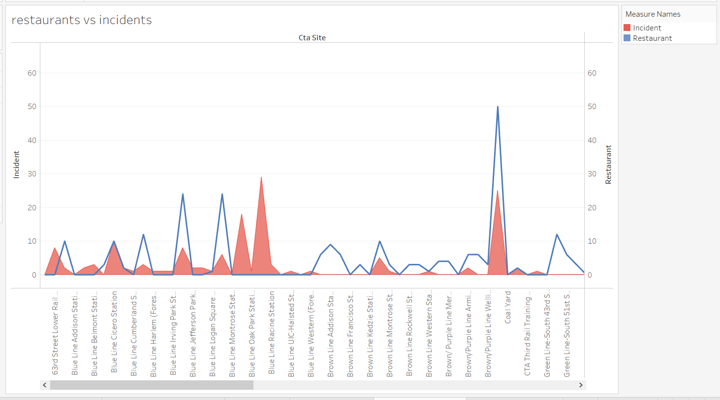
Similar to the previous dual axis graph, this one describes the proportion on crime incidents as per the number of restaurants near a CTA site.

Slide 23
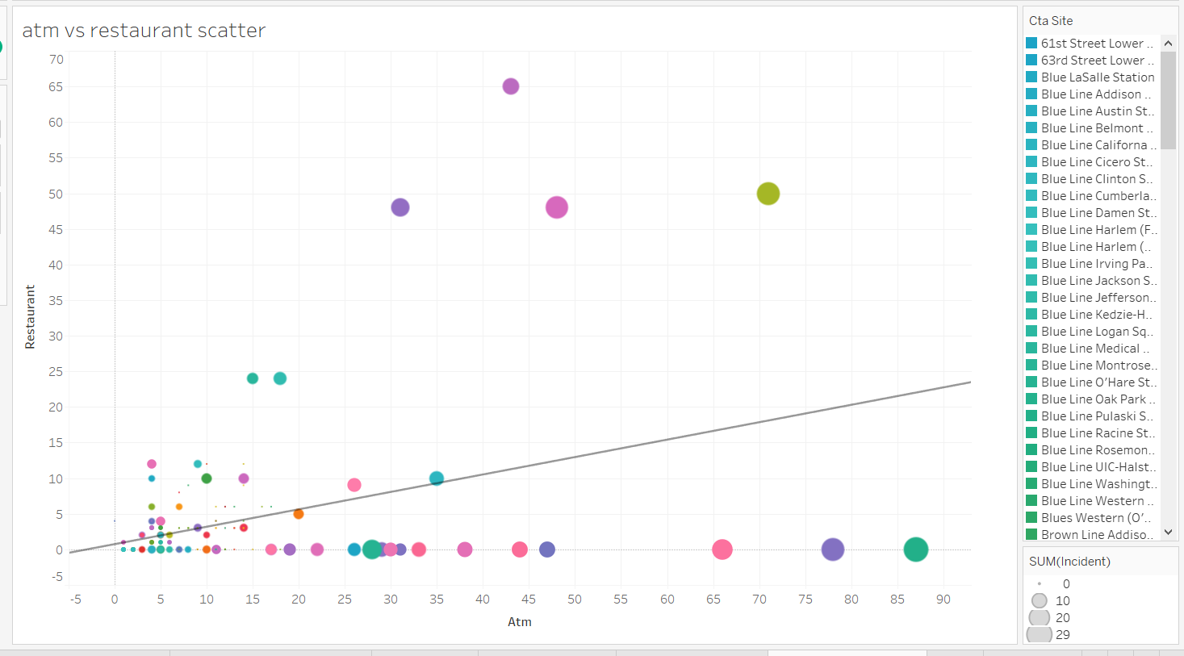
The above scatter chart displays the size as per no. of incidents against the count of both restaurants and ATMs near a CTA site. The trend line describes that more crime incidents happen in area with greater no. of restaurants and ATMs.

Slide 24

CONCLUSION
From statistical analysis we can see that the wednesday is the day having more crime in past three months.
Also most of the crime happened during late night around(0:00 am to 4:00 am)
Blue Line Pulaski has highest rate of Crime also the ATM and Restaurant count affects the number of Crimes.
Disturbance is the type of Crime which happens the most in incident types
Covid-19 stay at home might create some bias in data which could affect the accuracy of these model.

Slide 25
Thank You
Stay home, stay safe!

